Slide 1

Nashville International Center for Empowerment
Volunteer Orientation
NICE
Volunteer Orientation

Slide 2


Nashville International Center for Empowerment (NICE) is a non-profit, community-based organization dedicated to empowering refugees and immigrants of Middle Tennessee through direct social services
and educational programs.
Notes:
“Fundamental to the mission of NICE is the elimination of the root causes of poverty within greater Nashville’s refugee and immigrant community, the creation of opportunities for upward socioeconomic mobility, and the social integration of those it serves.”
“We aim to increase our clients’ abilities to effectively read, write, and speak English, facilitating long-term independence and stability by leading to sustainable employment and self-sufficiency for adults and ongoing academic achievement for children, thereby addressing the underlying issues contributing to poverty in our community.”

Slide 3

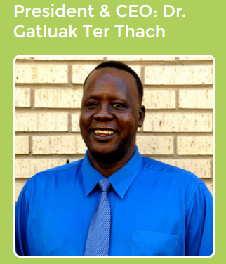
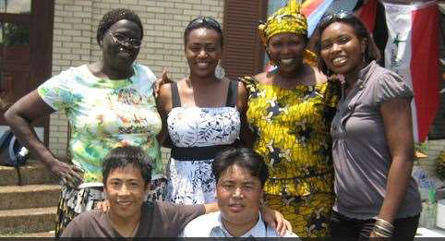

2005: Sudanese Community and Women’s Services Center founded.
2010: Renamed Nashville International Center for Empowerment (NICE).
NICE became a resettlement agency.
2015: Nice has expanded to serve over 15,000 people from 72 nations, serving over 2200 people in 2014 alone. NICE has grown from a staff of one to 25 employees that speak 37 languages.
Notes:
Founded by a group of Sudanese refugee men and women, including current director Dr. Gatluak Ter Thach, desiring to help other refugees and immigrants living in Middle Tennessee. The experiences of these founders, most of whom came to the US in the 1990s from war-torn Sudan, prompted the creation of NICE in an attempt to provide others with skills that would facilitate independence and self-sufficiency in their new home.
SCWSC was renamed NICE in order to more fully represent the services we provide and the community we serve. Since our founding, we have served people from more than 72 different nations currently living in Middle Tennessee, the majority whom have been of Asian, African, and Middle Eastern descent.
Many of our employees are or were refugees themselves. NICE employees speak a total of 32 different languages

Slide 4

NICE 6 core programs
Education
Employment
Immigration
Health
Resettlement
RISE
Notes:
Education: Adult ESL, After School Youth, Citizenship Training, and Computer Skills Courses
Employment: Workforce Preparation Program, including skills inventories, job search, online/paper application assistance, resume building, interview preparation, and weekly job training classes.
Health: Following the development of the Nashville Refugee Health Initiative in 2013, NICE developed a health program to provide education to the refugee and immigrant communities in MT. Consists of four components: Wellness Partner Program, monthly nutrition classes, weekly fitness classes, and monthly health screenings.
Immigration: Aiming to enable our clients to effectively and efficiently transition into life in MT, we have Board of Immigration Appeals accredited staff member, and our services include completing and filing immigration forms, providing interpretation, consultation services, and immigration case follow-up.
Resettlement: Our team meets clients at the airport, ensures home cooked meal and orients new arrivals to their new life. We hlep meet immediate needs such as furnishing homes, scheduling initial medical screenings, enrolling children in schools. Through our Match Grant, Refugee Cash Assistance, Refugee Medical Assistance, and Refugee Social Services programs we work to break down barriers between life as a refugee and self-sufficiency.
Refugee Integration Support and Empowerment: RISE (Refugee Integration Support and Empowerment) assists refugees that have been in the USA at least 8 months but less than 5 years and not currently enrolled in a federally funded program. The overarching goal of RISE is to empower refugee families and communities. The RISE program components are designed to address barriers to self-sufficiency while also building capacity among ethnic community members to advocate for their self-sufficiency. The RISE grant targets Burmese, Bhutanese, Somali, and Iraqi communities, but the programs are open to all refugees/asylees.

Slide 5
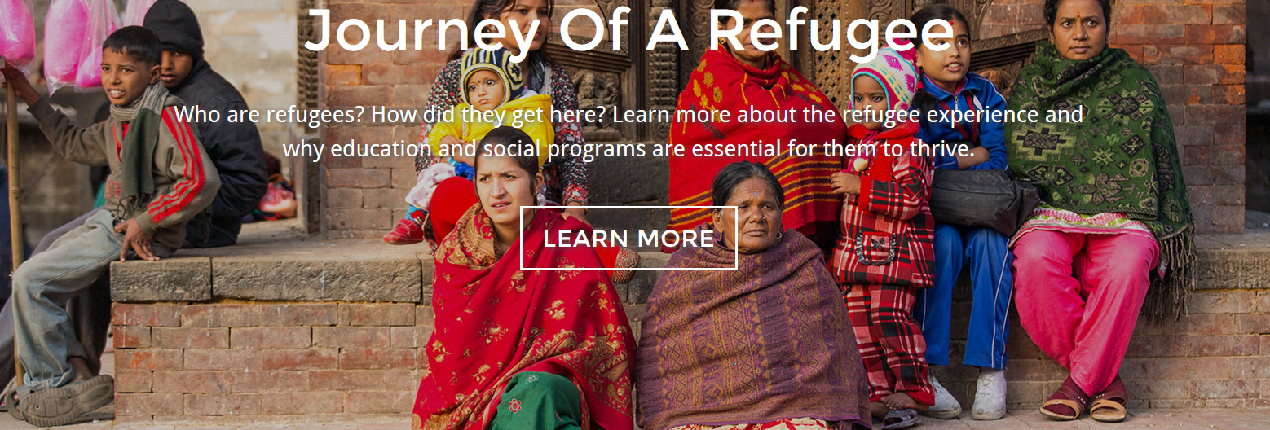

Slide 6
Refugee or Asylee or Immigrant?
Refugees are people who "owing to a well-founded fear of being persecuted for reasons of race, religion, nationality, membership of a particular social group or political opinion, are outside the country of their nationality, and are unable to, or owing to such fear, are unwilling to avail himself of the protection of that country
An asylum seeker applies for the right to be recognized after arriving in the country where they seek sanctuary. Asylum seekers may be forced to return to their home country if not granted asylum.
An immigrant is someone from a foreign country who relocates to live in another country. Immigrants move by choice and due to promise of a better life. However, they still have a choice to return to their own country at any time.
Notes:
The UNHCR defines a refugee as a person who flees his or her country and is unwilling or unable to return due to a well-founded fear. This fear is based on persecution for reasons of race, religion, nationality, membership in a particular social group, or for political opinion (Tennessee Office for Refugees).
Asylees are like refugees, with the exception that asylees arrive in the US on their own as students, tourists, businesspeople, or without any immigration status at all. After they have entered the country or reached a port of entry, they apply for and may receive a grant of asylum, acknowledging that they meet the legal definition of a refugee and are permitted to stay in the US.

Slide 7
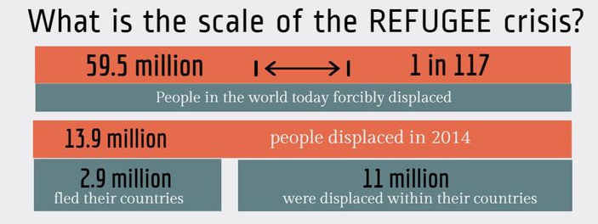


Slide 8
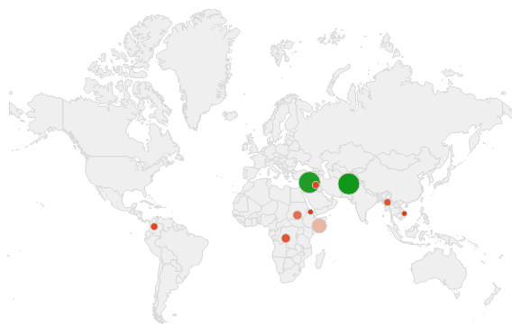
Around the World
Origin countries with the highest number of refugees, 2013
Afghanistan 2,556,600
Syria 2,468,400
Somalia 1,121,700
Sudan 649,300
DRC 499,500
Myanmar 479,600
Iraq 401,400
Columbia 396,600
Vietnam 314,100
Eritrea 308,000
Syria now is over 3.9 million
Statistics from UNHCR: http://www.unhcr.org/53a155bc6.html
Notes:
“During the year, UNHCR submitted 93,200 refugees to States for Resettlement ,and some 71,600 departed with UNHCR’s assistance. According to government statistics, 21 countries admitted 98,400 refugees for resettlement during 2013 (with or without UNHCR’s assistance). The United States of America received the highest number (66,200).” (UNHCR 2013)
“By the end of 2013, an estimated 51.2 million persons worldwide were considered to be forcibly displaced due to persecution, conflict, generalized violence, or human rights violations. These included 16.7 million refugees, 33.3 million internally displaced persons (IDPs), and close to 1.2 million individuals whose asylum applications had not yet been adjudicated by the end of the reporting period. The 2013 levels of forcible displacement were the highest since at least 1989, the first year that comprehensive statistics on global forced displacement existed. If these 51.2 million persons were a nation, they would make up the 26th largest in the world.”

Slide 9
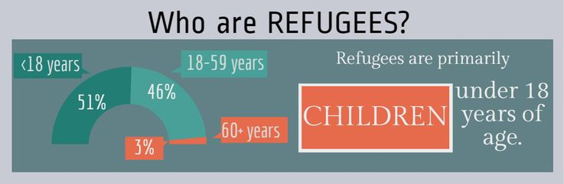


Slide 10

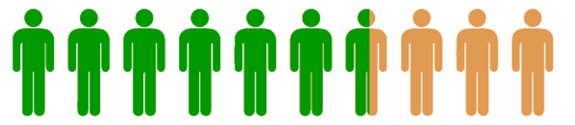
Around the World
51.2m
If the 51.2 million displaced persons around the word were a nation, they would make up the 26th largest in the world.
21 countries admitted 98,400 refugees for resettlement during 2013.
67%
Of the 98,400, the United States received the highest number, 66,200.
98,400
Graphics from Canva
Statics from UNHCR 2013 Report
Notes:
“During the year, UNHCR submitted 93,200 refugees to States for Resettlement ,and some 71,600 departed with UNHCR’s assistance. According to government statistics, 21 countries admitted 98,400 refugees for resettlement during 2013 (with or without UNHCR’s assistance). The United States of America received the highest number (66,200).” (UNHCR 2013)
“By the end of 2013, an estimated 51.2 million persons worldwide were considered to be forcibly displaced due to persecution, conflict, generalized violence, or human rights violations. These included 16.7 million refugees, 33.3 million internally displaced persons (IDPs), and close to 1.2 million individuals whose asylum applications had not yet been adjudicated by the end of the reporting period. The 2013 levels of forcible displacement were the highest since at least 1989, the first year that comprehensive statistics on global forced displacement existed. If these 51.2 million persons were a nation, they would make up the 26th largest in the world.”

Slide 11
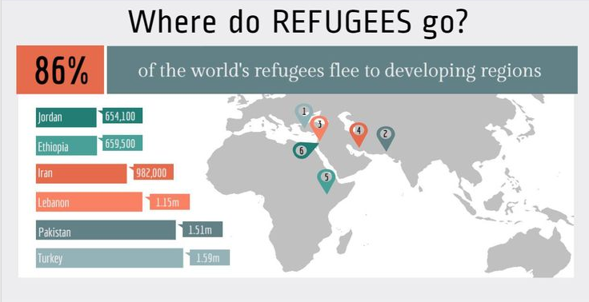

Slide 12
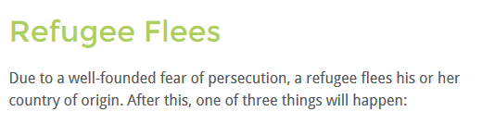

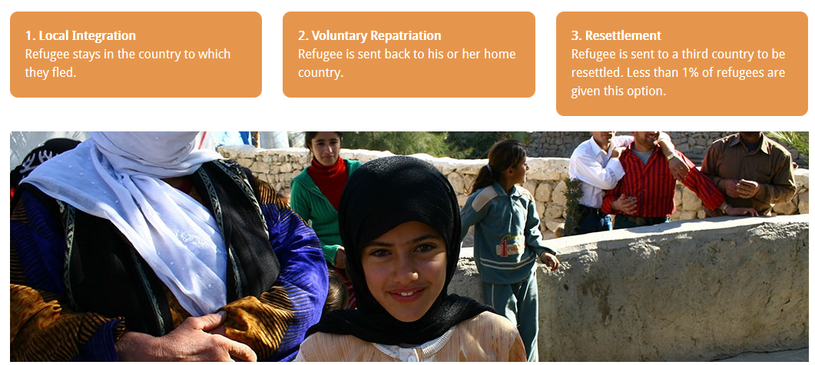
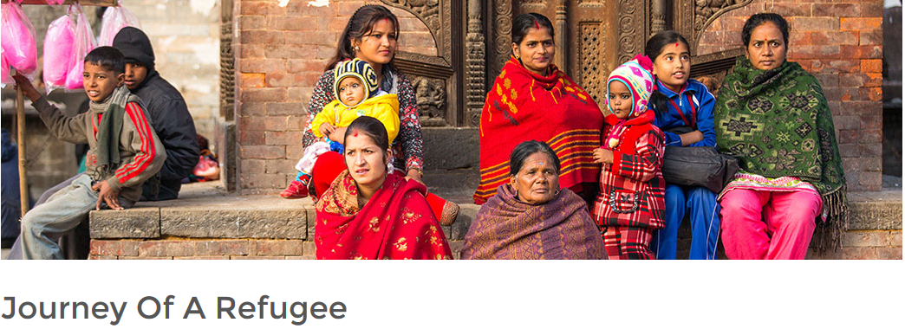

Slide 13
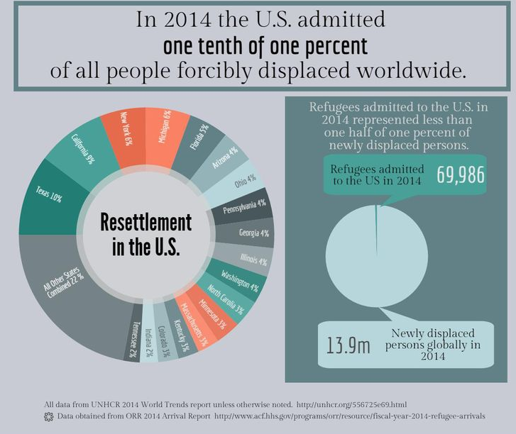
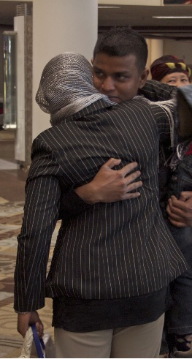

Slide 14
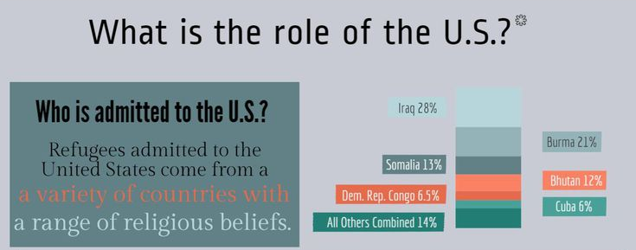

Slide 15
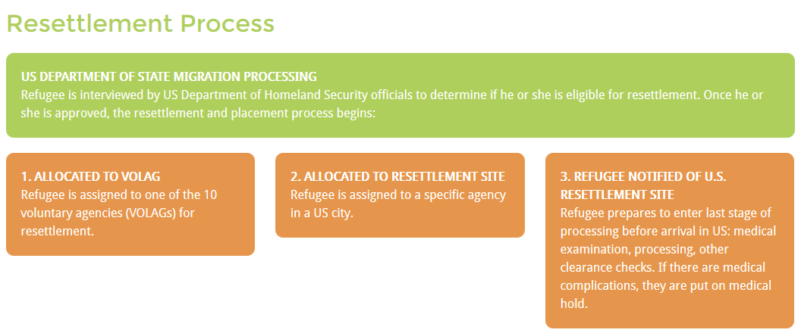
United States Resettlement Process

Slide 16
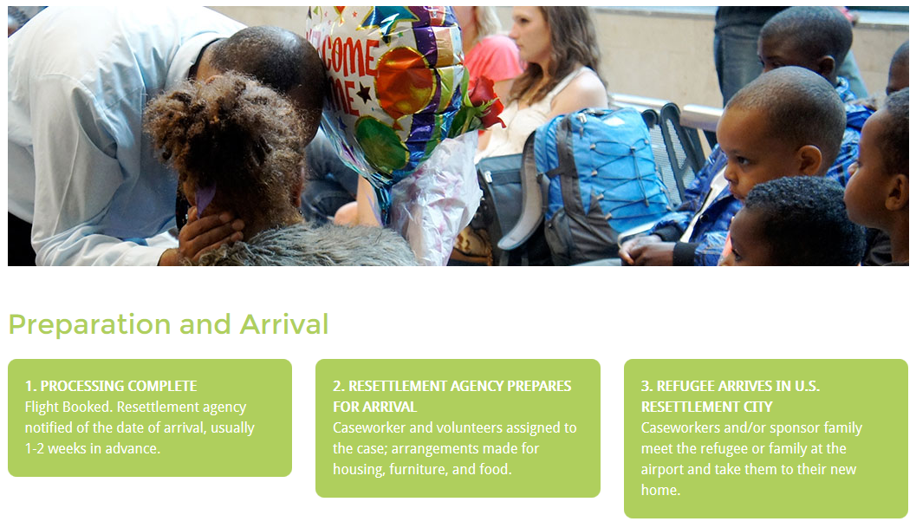

Slide 17
Tennessee Refugee Population
2014 saw the arrival of 1683 refugees to Tennessee*
73% in Nashville
4% in Chattanooga
12% in Memphis
10% in Knoxville
Notes:
As of 2012, there were about 57,869 refugees in Tennessee, which is less than 1% of the population
70% of incoming refugees are joining families already here
Davidson County takes in more than half of the entire state’s incoming refugees

Slide 18
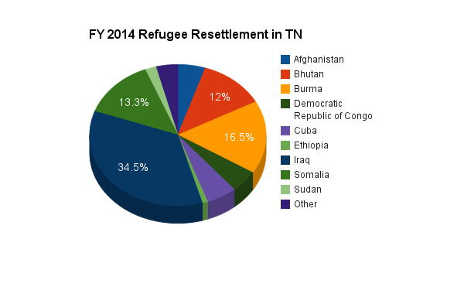
Tennessee Refugee Population
*
*”Other” includes populations from Colombia, Ecuador, Egypt, Eritrea, The Gambia, Iran, Jordan, Lebanon, Moldova, Nepal, Palestine, Rwanda, and South Sudan.
**Statistics from Tennessee Office for Refugees.

Slide 19

Why We Need You
Volunteers and Interns are essential to the mission of NICE. Every donation of time that you serve with our organization, you contribute to improving the lives of refugees in Nashville!

Slide 20
Volunteering/Interning at NICE
Confidentiality
Attendance
Dress Code
Supervision
Grievances
Notes:
Confidentiality: Information relating to the activities of NICE or its affiliates is confidential and protected from improper use or disclosure under state and federal law. We value and respect your confidentiality as a volunteer, and we will never disclose, sell or distribute any of your information. Volunteers who disclose any confidential information regarding employees of NICE, refugee students and families are subject to disciplinary action, up to and including dismissal.
Attendance: Volunteers play a crucial role in our many programs. It is important to our program that volunteers are reliable and are willing to follow through on their commitments. If a conflict arises that renders you unable to volunteer as scheduled, we ask that you give us at least 24 hours notice of absence. However, depending on the program you volunteer with, we may need notice even further in advance. Please keep the Volunteer Coordinator’s phone number readily accessible should you need to contact us. We understand that emergency situations arise which make it difficult to give 24 hours notice. If you find yourself in such a situation, please just notify us as soon as possible.
Dress Code: Comfortable and practical, but not offensive or distracting. Volunteers should wear a volunteer badge, available at the reception desk, during service hours.
Supervision: All NICE volunteers will report directly to the Volunteer Coordinator or the NICE staff member under which the volunteer serves. Should you have any questions, concerns,suggestions, or disagreements with your supervisor, please feel free to bring them to the attention of the Volunteer Coordinator.
Grievances: Please bring any problems or concerns related to your position or to other NICE employees or volunteers directly to the Volunteer Coordinator and complete an incident report form. We will make every effort to address the concern. If your concern relates to the Volunteer Coordinator, please bring it to the attention of our Human Resources Department.

Slide 21
Code of Conduct
Prohibited Behaviors
Bringing weapons of any description to any locations or assignments sponsored by NICE
Volunteering under the influence of alcohol or drugs
The use of cigarettes by a minor or the sale or distribution of cigarettes by an adult to a minor
Engaging in abusive, violent, or threatening behavior or language toward clients, staff, or other volunteers
Any intentional damage, destruction, or misuse of NICE property
Any form of sexual harassment
Any theft or removal of NICE property without permission
Notes:
While volunteering for NICE, we expect our volunteers to be respectful and courteous to others at all times. It is important that our children’s and families’ experience is a positive one! If at any time a volunteer is seen or believed to be engaging in the behaviors listed, they will be dismissed from their assignments immediately.

Slide 22
Your Rights & Responsibilities
Rights
Responsibilities
Safe and healthy work environment
Understand your role
Receive orientation and training
Refuse a task you are not comfortable with
Free of exploitation
Personal information kept confidential
Be reliable and punctual
Serve willingly
Ask for support when needed
Respect others and confidentiality
Complete agreed upon tasks to the best of your abilities
Participate in necessary trainings
Be safe

Slide 23
Things to Remember
Cultural Awareness
Our clients base is tremendously diverse, in cultural background and religion. We ask that you
be respectful and understanding, avoiding clothing or behavior that could be offensive.
Refrain from Proselytizing
Much of our funding comes from government grants so we are not a faith-based organization. As you are volunteering, we ask that you refrain from sharing
your personal beliefs.

Slide 24

Questions?
Contact: Kathy Edson, Director of Outreach and Community Engagement
Kathy@empowernashville.org
Notes:
FAQs:

Slide 25
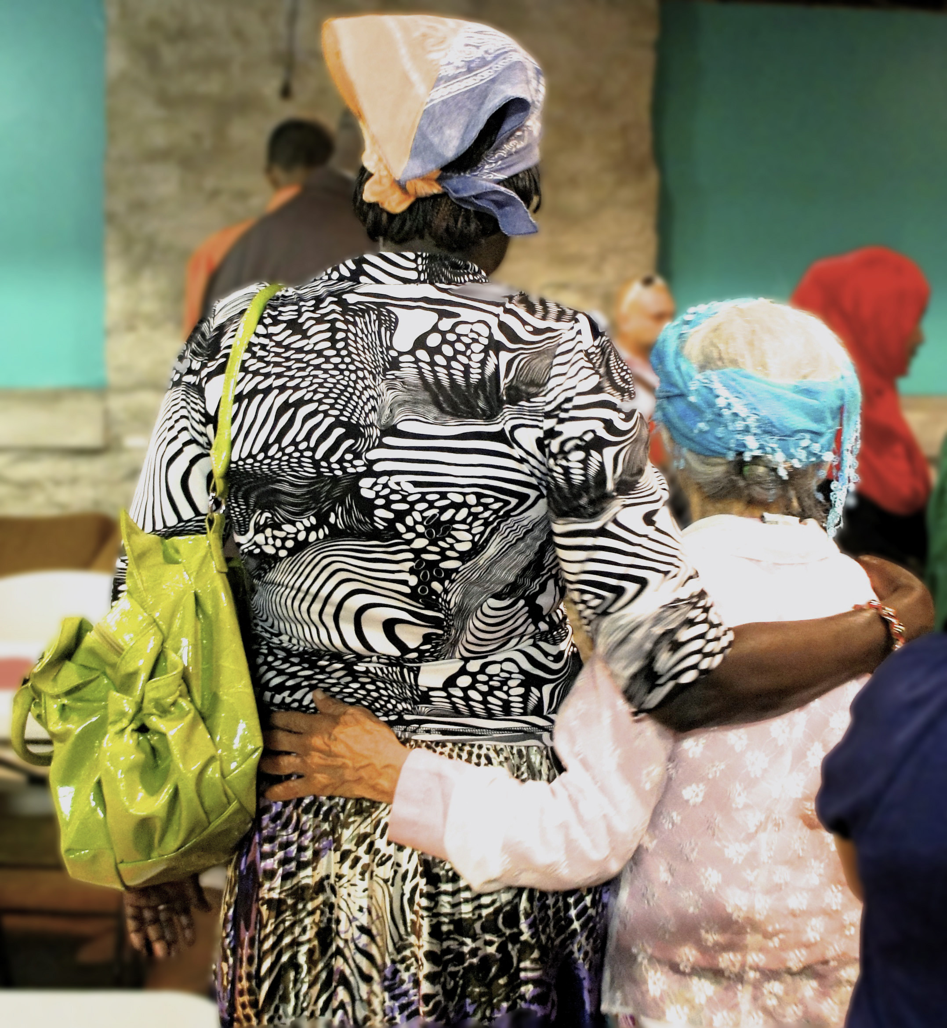

Thank You!

